Slide 1
JPEG Image Compression
CSCI-B 456 Final Project
By: Matthew Lonis

Slide 2
What is Image Compression?
Image Compression is a means of reducing the size of the raw image data into a smaller file format.
This can be done by simply shrinking the image or by various compression techniques.
Compression typically removes unnecessary data in the original image that produces an image with much less data but retains enough of the original information to still be recognizable and retain the core components of the image.

Slide 3
Types of Image Compression
Lossless
This type of compression is a compression in which the compressed data can be perfectly reconstructed to form the original image.
Lossy
This type of compression is a compression method in which a certain amount of data is lost and can never be reconstructed.
An image reconstructed from the lossy data is in no way the same as the original image but it is usually similar enough.

Slide 4
What is JPEG?
A committee called the Joint Photographic Experts Group (JPEG) created the lossy algorithm for compressing images into JPEG format.
At a high level, the JPEG compression algorithm works by removing high frequency colors in the YCbCr color space.
The reason for this is based on our human biology: Humans can’t see or easily distinguish colors at high frequencies of light.

Slide 5
High Level Overview of the Algorithm
Gridding: Grid the image into 8x8 blocks of pixels. If the image cannot be evenly divided into blocks of 8, we need to zero-pad the image.
Color Space Transformation: Transform the image from the RGB color space to the YCbCr color space and down sample the image.
Discrete Cosine Transformation: Take the DCT of each 8x8 pixel block.

Slide 6
High Level Overview of the Algorithm
Quantization: Quantize the DCT coefficients according to standard JPEG quantization tables.
Vectoring:
Perform zigzag scanning on each 8x8 block to convert the 8x8 matrix into a 1D vector.
Differential Pulse Code Modulation (DPCM) on DC components.
Run Length Encoding (RLE) on AC components.
Huffman Coding: Compress the entire image using Huffman Coding.

Slide 7
Gridding
The original image is divided into 8x8 blocks of pixels, 64 pixels in total. Each of these grids will be referred to as blocks throughout the entirety of this presentation.
As far as coding this in MATLAB, it is easier to merely process the image 1 block at a time as opposed to truly dividing the image into 8x8 blocks into some other data structure like an array.

Slide 8
Color Space Transformation
JPEG works on an image in the YCbCr color space as opposed to the RGB color space.
It is easiest to convert the image to YCbCr in MATLAB by use of the function rgb2ycbcr.
The YCbCr color space is made up of the following:
Y = Brightness or Luminance
Cb = Chroma Blue
Cr = Chroma Red

Slide 9
Color Space Transformation
As a part of the color space transformation we need to down sample the Cb and Cr color profiles since the human eye is less noticeable of color changes than with luminance changes.
A moderate down sampling is down sampling the Cb and Cr color profiles by a factor of 2.
This is easily achieved in MATLAB by using the function imresize to scaled down the Cb and Cr color profiles by 0.5 and then re-sizing the profiles by a factor of 2 to get back to the original size.

Slide 10
Discrete Cosine Transformation
The DCT uses the Cosine function, hence its name, to avoid interacting with complex numbers and still convert each block from the spatial domain into the frequency domain.
We need to convert to the frequency domain in order to exploit the fact that human vision is less sensitive to high frequency data.

Slide 11
Discrete Cosine Transformation
Although there is a formula for the DCT, it is easiest to construct the DCT matrix D. From there, to convert each block into the frequency domain, via DCT, we merely need to multiply each block by the formula below:
D * Block.data * D’
Where D’ corresponds to the transposed D matrix.
The DCT Matrix is shown on the next slide

Slide 12
DCT Matrix for 8x8 Blocks
0.3536 | 0.3536 | 0.3536 | 0.3536 | 0.3536 | 0.3536 | 0.3536 | 0.3536
0.4904 | 0.4157 | 0.2778 | 0.0975 | -0.0975 | -0.2778 | -0.4157 | -0.4904
0.4619 | 0.1913 | -0.1913 | -0.4619 | -0.4619 | -0.1913 | 0.1913 | 0.4619
0.4157 | -0.0975 | -0.4904 | -0.2778 | 0.2778 | 0.4904 | 0.0975 | -0.4157
0.3536 | -0.3536 | -0.3536 | 0.3536 | 0.3536 | -0.3536 | -0.3536 | 0.3536
0.2778 | -0.4904 | 0.0975 | 0.4157 | -0.4157 | -0.0975 | 0.4904 | -0.2778
0.1913 | -0.4619 | 0.4619 | -0.1913 | -0.1913 | 0.4619 | -0.4619 | 0.1913
0.0975 | -0.2778 | 0.4157 | -0.4904 | 0.4904 | -0.4157 | 0.2778 | -0.0975

Slide 13
DC & AC Components
For each block, the pixel at index (0, 0) is referred to as the DC Component in the block.
This is because when performing the DCT, the function stores the mean of all 64 values in the block at (0, 0). This is just a mathematical phenomenon of the DCT.
For all other pixels in the block, they are referred to as AC Components since they actually have a frequency value associated with the pixel.

Slide 14
Quantization
Since humans struggle to see high frequencies, we can take advantage of this and zero out, or remove, high frequency data in an image up to a certain point.
This is where the real data loss occurs in the JPEG algorithm.
This reduces the overall bits needed for the image and helps further compress the data.
This also is another huge reason JPEG compression is a lossy compression mechanic.

Slide 15

Quantization
In order to quantize a particular block of pixels, we need to perform the following formula:
$X\left(u, v\right)=Q\left(u, v\right)∗round\left(\frac{F\left(u, v\right)}{Q(u, v)}\right)$
$X\left(u, v\right)$ represents the final block after quantization
$Q\left(u, v\right)$ represents the 8x8 quantization matrix
F$\left(u, v\right)$ represents the original block of pixels

Slide 16
Quantization
The JPEG standard usually defines quantization matrices as per the JPEG standard. A quantization matrix is use for the Y channel and another matrix used for the Chroma channels.
The matrices are as follows:
Luminance Quantization Matrix
16 | 11 | 10 | 16 | 24 | 40 | 51 | 61
12 | 12 | 14 | 19 | 26 | 58 | 60 | 55
14 | 13 | 16 | 24 | 40 | 57 | 69 | 56
14 | 17 | 22 | 29 | 51 | 87 | 80 | 62
18 | 22 | 37 | 56 | 68 | 109 | 103 | 77
24 | 35 | 55 | 64 | 81 | 104 | 113 | 92
49 | 64 | 78 | 87 | 103 | 121 | 120 | 101
72 | 92 | 95 | 98 | 112 | 100 | 103 | 99

Slide 17
Quantization
Chrominance Quantization Matrix
The entries in each matrix tend to increase as you move towards the bottom right of the matrix in order to introduce more loss as we approach high frequencies.
17 | 18 | 24 | 47 | 99 | 99 | 99 | 99
18 | 21 | 26 | 66 | 99 | 99 | 99 | 99
24 | 26 | 56 | 99 | 99 | 99 | 99 | 99
47 | 66 | 99 | 99 | 99 | 99 | 99 | 99
99 | 99 | 99 | 99 | 99 | 99 | 99 | 99
99 | 99 | 99 | 99 | 99 | 99 | 99 | 99
99 | 99 | 99 | 99 | 99 | 99 | 99 | 99
99 | 99 | 99 | 99 | 99 | 99 | 99 | 99

Slide 18
Vectoring: Zig-Zag Scan
The next step is to map each 8x8 block to a 1x64 vector using the zig-zag method.
We use the zig-zag method to exploit the large amount of zeros in the bottom right of the blocks due to our quantization.

Slide 19
Vectoring: DPCM
The next step is to perform Differential Pulse Code Modulation (DPCM) on the DC components of each zig-zag vector.
This is performed by subtracting the DC component in a vector by the DC component in the previous vector and storing that as the DC component.
The reason for this is because the DC component is usually large, compared to the rest of the data, but is often similar to the previous DC component allowing us to store the DC components as a smaller number.

Slide 20
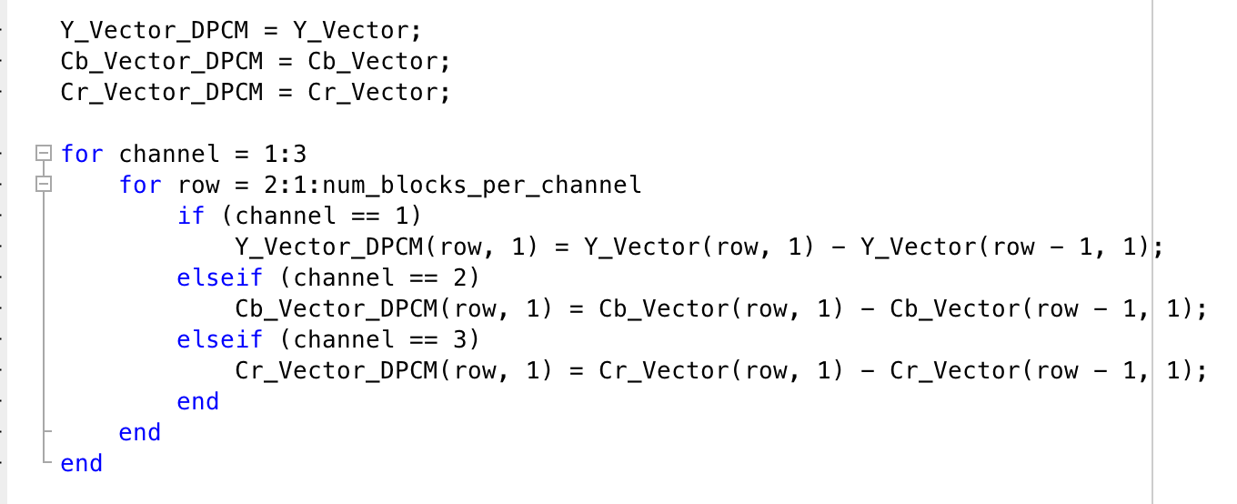
DPCM Code Example

Slide 21
Vectoring: RLE on AC Components
The next step is to apply run length encoding on the remaining AC components.
The remaining 63 values in each vector will have a lot of zeros in it.
We can encode this in a more efficient way by counting the number of zeros preceding the next non-zero value and store it as (0, count).

Slide 22
RLE Example
Original Vector
RLE Vector
1 | 0 | 0 | 0 | 0 | 3
1 | 0 | 4 | 3 | 0 | 0

Slide 23
RLE Continued
At first it may seem like it isn’t compressing the vector by much since we have to send 0,0 as the end values. The example below will show why it can be so useful:
Original
RLE
We have reduced the RLE array to 9 values instead of 24
1 | 0 | 0 | 0 | 0 | 0 | 0 | 0 | 0 | 0 | 0 | 0 | 0 | 0 | 0 | 0 | 0 | 0 | 7 | 0 | 0 | 0 | 0 | 9
1 | 0 | 17 | 7 | 0 | 4 | 9 | 0 | 0

Slide 24
Huffman Coding
We need to represent the final vectors with a smaller number of bits to truly compress the image.
We use Huffman coding since it achieves significant levels of compression by replacing common values with shorter code words.
The scope of Huffman coding is out of reach for my project, as far as how it works.
It is far easier to code via Huffman using built in Huffman tools in MATLAB’s Communications System Toolbox

Slide 25
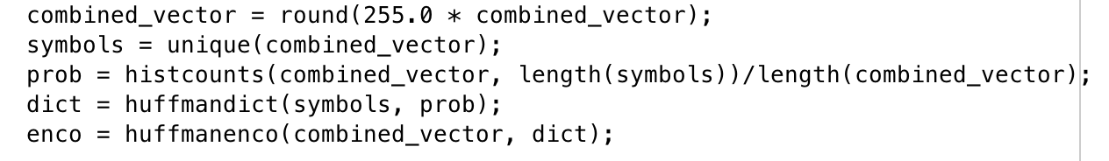
Huffman Coding Code Example
In the code below, I am first multiplying the combined 1D vector of all three channels by 255 and rounding due to the values being doubles and extremely similar.
Then I get the unique values and use those for my symbols.
Next I get the probability of each “symbol”.
Finally I create my Huffman dictionary using a built-in function and encode the vector.
I found this to be the easiest and quickest way to get Huffman coding working.

Slide 26
Next Steps
From here, it is a matter of decoding the Huffman codes, reversing the RLE and DPCM, and running the Inverse DCT on the blocks to reconstruct the image.
The inverse DCT is as simple as the DCT where the formula is
D’ * Block.data * D
Where D’ corresponds to the transposed D matrix.

Slide 27
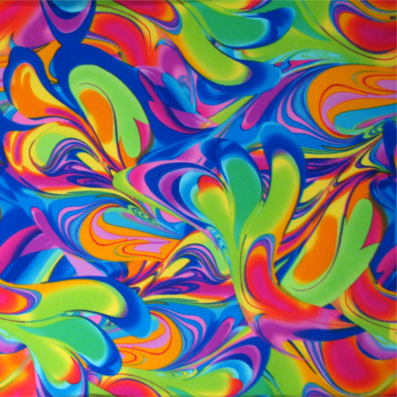
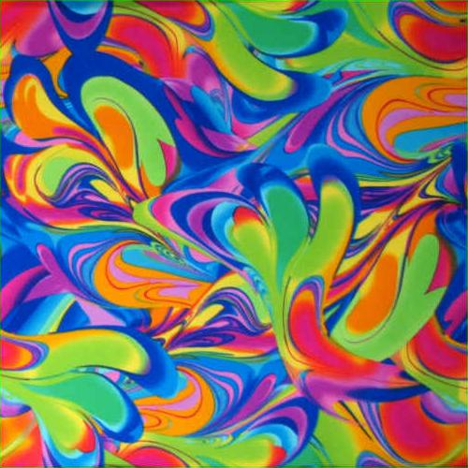
My Results

Slide 28
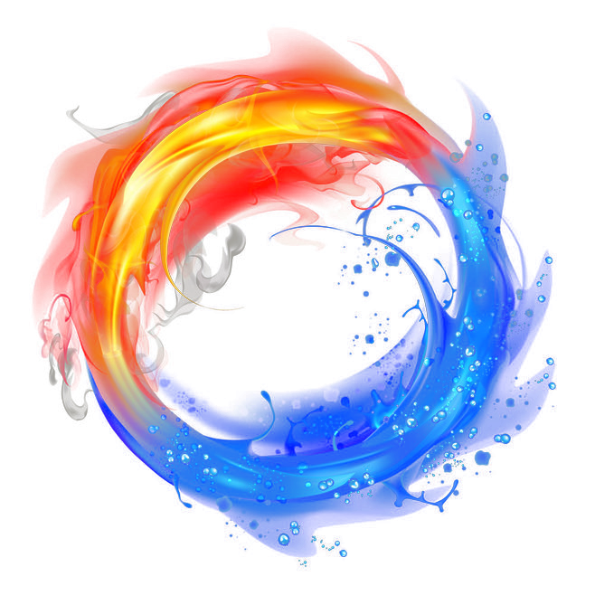
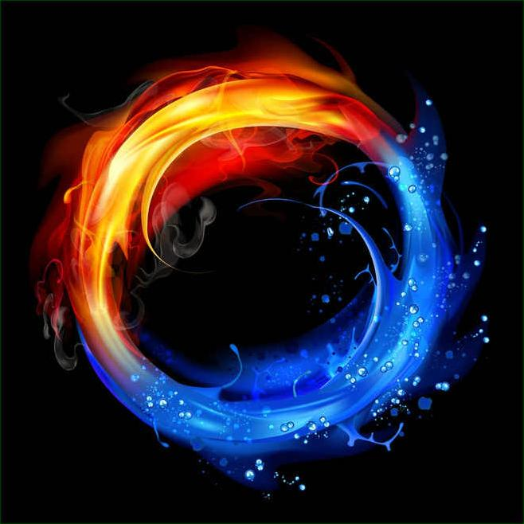
More Results

Slide 29
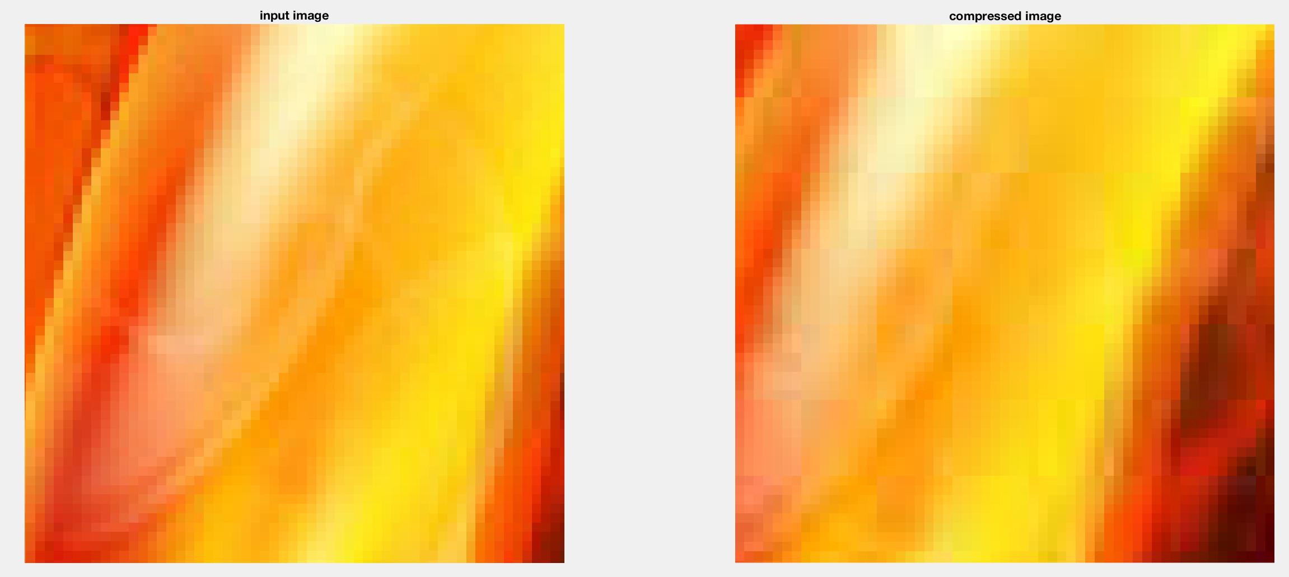
Affects of Gridding

Slide 30
Attempted Improvements
There are relatively few improvements to be made to the core JPEG algorithm since it is a defined standard.
Image quality and compression can both be controlled by changing the down sampling factor as well as the quantization tables.
The only improvements possible were in performance improvements.

Slide 31
Attempted Improvements
My biggest speed improvement was performing DCT with a matrix as opposed to using the actual DCT summation function as MATLAB performs slowly with for loops.
Time to complete DCT = 2.400000e-01 seconds as opposed to 3 or 4 seconds if not more depending on the size of the image.
This is also a speedup for Inverse DCT since it uses matrices as well.

Slide 32
References
https://www.mathworks.com/help/images/discrete-cosine-transform.html
http://www.math.cornell.edu/~web6140/TopTenAlgorithms/JPEG.html
https://www.slideshare.net/AishwaryaKM1/jpeg-image-compression-56894348
https://ac.els-cdn.com/S1077201485710054/1-s2.0-S1077201485710054-main.pdf?_tid=306bb1bb-db22-4c5f-b88c-bda38f187ed9&acdnat=1522776649_26a516e5427579b7267d3792cbe6c676
http://www.iraj.in/journal/journal_file/journal_pdf/1-10-139036859144-46.pdf
https://www.researchgate.net/publication/268523100_THE_JPEG_IMAGE_COMPRESSION_ALGORITHM

